Slide 1
Module 6
Basic Data Exploration Techniques in R

Slide 2
Contents
Measuring categorical variation with a bar chart x
Measuring continuous variation with a histogram x --bandwidth
Measuring covariation with boxplots x---y
Measuring covariation with symbol size x---y(types)
Creating 2D bins and hex charts x---y
Generating summary statistics

Slide 3
Basic Data Exploration Techniques in R
Exploratory Data Analysis (EDA) is a workflow designed to gain a better understanding of your data.
The workflow consists of three steps.
The first is to generate questions about your data. In this step you want to be as broad as possible because at this point you don’t really have a good feel for the data.
Next, search for answers to these questions by visualizing, transforming, and modeling the data.
Finally, refine your questions and or generate new questions.
In R there are two primary tools that support the data exploration process: plots and summary statistics.

Slide 4
Basic Data Exploration Techniques in R (cont….)
Data can generally be divided into categorical or continuous types.
Categorical variables are often visualized with bar charts, and continuous variables with histograms.
Variation or covariation are measured when performing basic visualization.
Variation is the tendency of the values of a variable to change from measurement to measurement. Example: total acres burned by a wildfire (continuous) or the number of crimes by police district (categorical data ).
Covariation is the tendency of the values of two or more variables to vary together in a related way

Slide 5
Measuring Categorical Variation with a Bar Chart
A bar chart is a great way to visualize categorical data.
It separates each category into a separate bar and then the height of each bar is defined by the number of occurrences in that category.
Exercise 1:
1. Make sure readr, dplyr and ggplot2 packages are loaded.
2. Use the read_csv()function to load the dataset into a data frame.
dfFires <- read_csv("StudyArea.csv", col_types = list(UNIT = col_character()),col_names = TRUE)

Slide 6
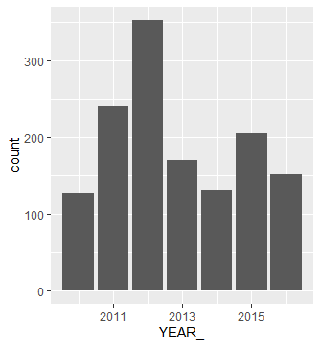
Exercise 1: (Cont….)
3. For this analysis, filter the data so that only fires that burned greater than 1,000 acres in the years 2010 through 2016 are represented.
df <- filter(dfFires, TOTALACRES >= 1000, YEAR_ %in% c(2010, 2011, 2012, 2013, 2014, 2015, 2016))
4. Produce a bar chart
5. Use the count() function to get the actual count for each category.
View(count(df, YEAR_))
ggplot(data = df) + geom_bar(mapping = aes(x = YEAR_))

Slide 7
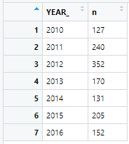
Exercise 1: (cont…)
5. Use the count() function to get the actual count for each category.
View(count(df, YEAR_))

Slide 8
Measuring Continuous Variation with a Histogram
The distribution of a continuous variable can be measured with the use of a histogram.
Exercise 2:
Load StudyArea.csv file using read_csv().
dfFires <- read_csv("StudyArea.csv", col_types = list(UNIT = col_character()),col_names = TRUE)
2. Pipe the data frame and use the select() function to limit the columns
and filter the rows so that only fires greater than 1,000 acres are
included.

Slide 9
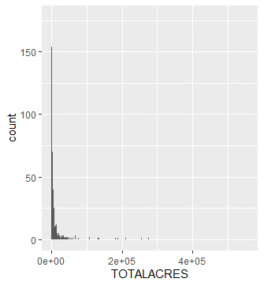
Exercise 2 (Cont…)
3. Create the histogram using ggplot() with geom_hist() and a bin size
of 500. Add the highlighted code you see below to produce the
chart.
df %>%select(ORGANIZATI, STATE, YEAR_, TOTALACRES, CAUSE) %>% filter(TOTALACRES >= 1000)%>%ggplot() + geom_histogram(mapping = aes(x=TOTALACRES), binwidth=500)

Slide 10
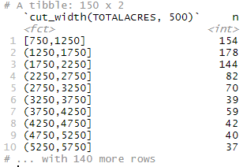
Exercise 2 (Cont…)
4. Get a physical count of the number of fires that fell into each bin.
From viewing the histogram and the count it’s obvious that the vast majority of fires are small.
df %>% count(cut_width(TOTALACRES, 500))
5. Challenge: Recreate the histogram using a bin size of 5000. What is the effect
on the output?

Slide 11
Measuring Covariation with Box Plots
Box plots provide a visual representation of the spread of data for a variable.
These plots display the range of values for a variable along with the median and quartiles.
Exercise 3:
Load StudyArea.csv file using read_csv().
dfFires <- read_csv("StudyArea.csv", col_types = list(UNIT = col_character()),col_names = TRUE)

Slide 12
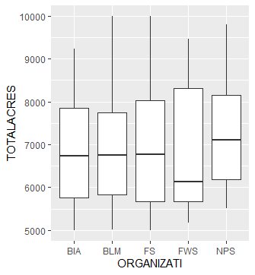
Exercise 3 (Cont…)
2. Pipe the data frame and filter the rows so that only fire between
5000 and 10000 acres are included.
Then, group the data by organization.
Finally, use ggplot() with geom_boxplot() to create a boxplot showing the distribution of wildfires by organization.
df %>%filter(TOTALACRES >= 5000 & TOTALACRES <= 10000) %>%group_by(ORGANIZATI) %>%ggplot(mapping = aes(x =ORGANIZATI, y = TOTALACRES)) + geom_boxplot()

Slide 13
Exercise 3 (Cont…)
The organization is listed on the X axis and the total acreage burned on the Y axis.
The box contains a horizontal line that represents the median for the variable and the box itself is known as the Inter Quartile Range (IQR).
The vertical lines that extend on either side of the box are known as the whiskers and represent the first and fourth quartile.
A larger box and whiskers indicate a larger distribution of data.
Challenge: Create a new boxplot that maps the covariation of CAUSE and TOTALACRES.

Slide 14
Measuring Covariation with Symbol Size
The geom_count() function can be used with ggplot() to measure covariation between variables using different symbol sizes.
Exercise 4:
Load StudyArea.csv file using read_csv().
dfFires <- read_csv("StudyArea.csv", col_types = list(UNIT = col_character()),col_names = TRUE)

Slide 15
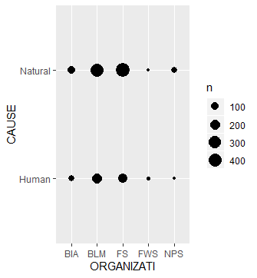
Exercise 4 (Cont…)
2. Pipe the data frame and filter the rows so that only wildfires that
originated due to Natural or Human causes are included.
This will remove any records that are Unknown or have missing values. Then, use geom_count() to create a
df%>%filter(CAUSE == 'Natural' | CAUSE == 'Human') %>%group_by(ORGANIZATI) %>%ggplot() + geom_count(mapping = aes(x = ORGANIZATI, y = CAUSE))
df %>%
count(ORGANIZATI, CAUSE)

Slide 16
2D bin and hex charts
2D bin and hex charts can be used as an alternative way of viewing the distribution of two variables.
Exercise 5:
Load StudyArea.csv file using read_csv().
2. Create a 2D bin map with YEAR_ on the X axis and TOTALACRES on
the Y axis.
ggplot(data = dfFires) + geom_bin2d(mapping = aes(x=YEAR_,y=TOTALACRES))
3. Create a 2D hex map with YEAR_ on the X axis and TOTALACRES on
the Y axis.
ggplot(data=df) + geom_hex(mapping = aes(x=YEAR_, y=TOTALACRES))

Slide 17
Generating Summary Statistics
Another basic technique for performing exploratory data analysis is to generate various summary statistics on a dataset.
Exercise 6:
Load StudyArea.csv file using read_csv() into dataframe df.
2. Restrict the list of columns.
df <- select(df, ORGANIZATI, STATE, YEAR_, TOTALACRES, CAUSE)
3. Filter the list to include only wildfires greater than 1,000 acres.
df <- filter(df, TOTALACRES >= 1000)

Slide 18
Exercise 6 (Cont…)
4. Call the mean() function, passing in a reference to the data frame and
the TOTALACRES column.
mean(df$TOTALACRES)
5. Call the median() function.
median(df$TOTALACRES)
6. Instead of calling the individual summary statistics functions you can
simply use the summary() function to return a list of summary
statistics.
summary(df$TOTALACRES)

